Slide 1
DBC-RA2
PLD
ACTION PLAN
No | Detail | P.I.C | Jan |  | Feb |  |  |  | Mar |  |  |  | Apr
 |  |  | 22-26 | 29-31 | 5-9 | 12-16 | 19-23 | 26-29 | 4-9 | 11-15 | 18-22 | 25-29 | 1-5 | 8-11 | 18-20 | 22-26
1 | Issue concept idea | Surasak / Supakorn
2 | Confirm detail get requirement / concept | Store PCB/IT member
3 | Design system | Supakorn
4 | Develop system | Supakorn
5 | Layout setting | Arnon
6 | Equipment support | Surasak/Armon
7 | Trail test | Store PCB/IT member
8 | Start use New system | Store PCB/IT member
9 | Follow up & action problem | Store PCB/IT member

Slide 2
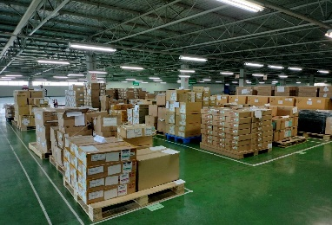
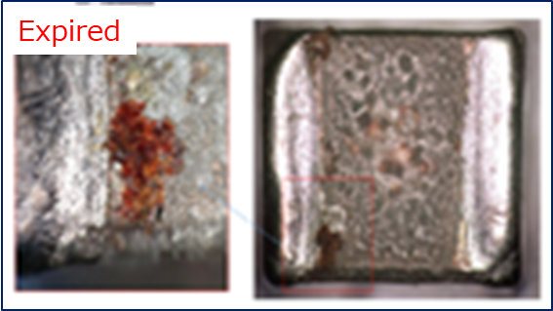
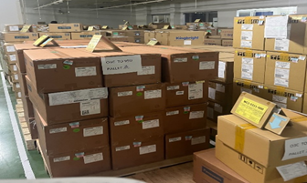
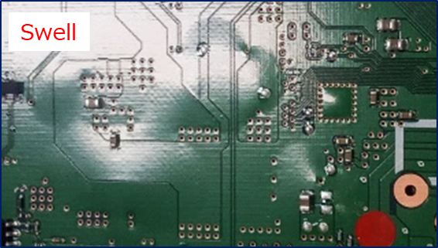
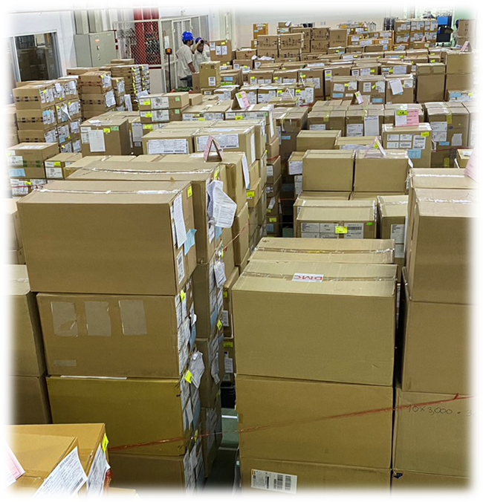
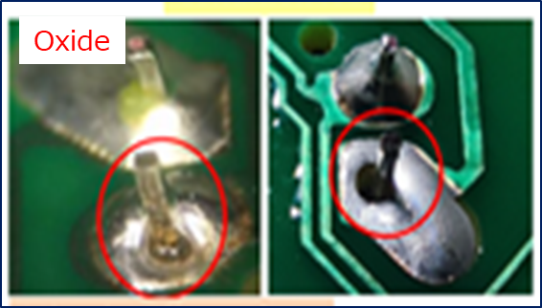
DBC-RA2
PLD
Background
PCB child parts it is a group of parts with global use and high market competition. Therefore, parts must be ordered to be stored for production. When the production plan is reduced, so do the remaining parts.
Stock remain Y2022 | Affect [Parts Expire] | Action
 |  | 1.Sort parts
 |  | 2.Self quality guarantee
 |  | 3.Control use of parts
HT
Amount 287.55MB.
[1,410 Items]
RA

Slide 3

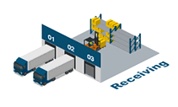
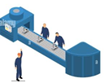
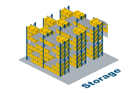
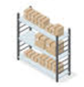


DBC-RA2
PLD
concept program , funtion
Link Sub_System
Receiving & Inspection
Free location
Store fixed
Picking store out
MFG3
Use part
Strategic
Combine
SSO

Slide 4
DBC-RA2
PLD
Purpose
Objective :
1) Progress stock Free/Fix location real time
2) FI-FO control quality up
3) Manage outstanding stock by implementing IT systems to control
4) Reduce work load check expired parts
5) Link system Strategic stock / Combine / SSO

Slide 5






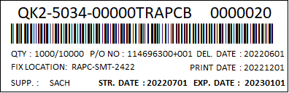



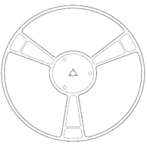




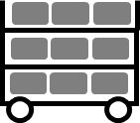

DBC-RA2
PLD
CONCEPT LINK SYSTEM CHILD PARTS PCB
Combine
system
SSO system
1) Receiving
2) Create label ***
3) Free location
4) Store Fixed
5) MIZU
6) PCB_ASS’Y
Scan EDI [SIAM]
2.1) Unpack
2.2) Check D/C
2.3) Scan EDI slip
2.4) Input D/C
2.5) Print Create label
2.6) Attach serial label at parts
2.7) Print cover list attach pallet parts
Strategy system
Double check
Conf. PNDB
Prepare part supply production
1) Store_PH1
Store_1
Scan EDI
Regist location free
Keep part free location refer PO
SMT
Store-in
Store-out
Hand
2) Store_CIS
Store_2
Flow
Scan serial in stock
Scan serial out stock
Store_3
SSO system
3) Store_ADM
PSU
Child PCB
Min-Max stock
Control free location
-1 part more location
Calling part
Free
Fix
Control expire part

Slide 6
DBC-RA2
PLD
TARGET
Child parts PCB = 1,856 items
PH1
1
2
 Area Store Child PCB control
3
No | Area
1 | Lobby
2 | ADM
3 | Medical
4 | CIS
5 | Store SMT
6 | Smart Store
7 | Store_3
 | TTL
MFG-3
4
5
6
7

Slide 7
DBC-RA2
PLD
Merit & Benefit (ROI)
No | Detail | Work load reduce [min.] | Items | Merit [min.] | Kutsu jin [Per.]
1 | Reduce work load add PO manual | 2.38 | 56 | 133.28 | 0.28
2 | Reduce work load input data part expired | 8.25 | 1,376 | 11,352.00 | 23.65
 | Total | 10.63 | 1,432 | 11,485.28 | 23.93
Draft
 Current use manpower check parts expired
Current use manpower [Per.] | Improve use manpower [Per.] | Reduce manpower [Per.]
7 | 4 | 3

Slide 8
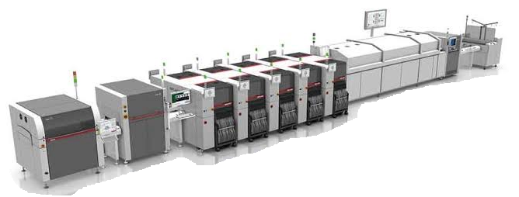





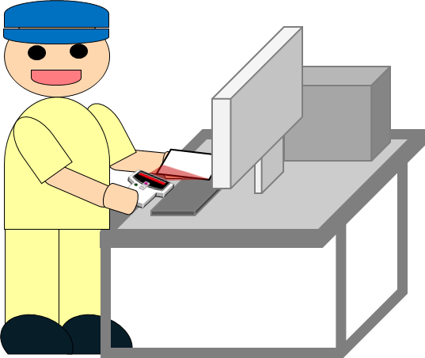
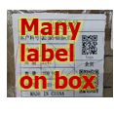



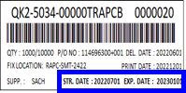
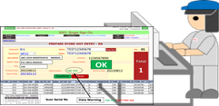


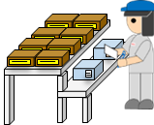

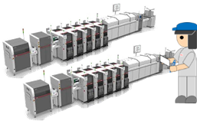
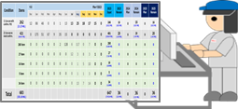
DBC-RA2
PLD
Process Flow / Operation system
Receiving & Inspection
Free location
Store fixed
Picking store out
MFG3
Use part
Parts 1,410 Items
Target check
59,601 lot
Move & keep part
Supply
1.Repackage
2.Create label
3.Store-In
Change
point
Detail | Operation flow/Lead time (Add Manpower = 33pers.,HT=20pers. RA = 13pers.)
 Sort parts [145 day 20 min.]
 | 120 day | 10 day | 10 min. | 15 day | 10 min.
Self quality guarantee [77 day 120 min.]
 | 60 day | 15 day | 2 day | 120 min. | 10 day
Control use of parts [40 day ]
 | 20 day | 20 day | Continue | Continue | Continue
1.Check lot label
2.Input lot code
3.Send E-mail to PEE
4.PEE confirm label
MFG. date
5.PEE send e-mail Reply to DBC
6.Separate parts
confirm MFG. date
7.Picking part from store
8.Issue document request input part
9.Meeting control
use parts
10.Create label control part expire
11.Keep part to
store in
12.Picking part store out
13.Receive part and checking part
14.MFG3 use parts
15.Update data use parts

Slide 9
3) Free location
Strategy system
Scan EDI
Regist location free
Keep part free location refer PO
1) Store_PH1
2) Store_CIS
3) Store_ADM

